Slide 1
Analysis of Song Popularity: What Makes a Song Popular?
By:
Aneesh Kauravlla
Angelica Balma
Bryan Lopez
Denis Cohen
Donald Mullen

Slide 2
Motivation & Summary
For this project we decided to investigate a song’s popularity and if/how there are defining characteristics that make a particular song more popular than another.
Our initial hypothesis is particular musical characteristics are direct correlators with a song’s popularity and based on these connections we can devise a prediction model to predict whether or not a song is popular.
In order to build our model we needed to analyze a population of songs and their musical characteristics. Where would we find a dataset that contained this info?
We discovered a dataset on Kaggle that contains 232,725 tracks pulled from Spotify’s music database via the Spotify API. The songs come from 26 different genres and the dataset also provided 14 different explanatory variables based on the song’s musical characteristics (We will discuss the explanations for each of the variables in a later slide)

Slide 3
Motivation & Summary Contd.
We did use the “popularity” variable in the dataset as our targeted dependent variable.
After exploring and running statistical models based on the data provided in the Spotify dataset, we were unable to find direct correlations between the inputs of the explanatory variables and the out of the song’s popularity. There was no significant correlation between any of the musical characteristics and the popularity variable.
Therefore, we decided to move a different direction. Continuing with the Spotify dataset, we defined our own category: Partybility. Using Spotify features, we searched for the most partyable genre. Looking for another resource, we decided to search the Billboard “Hot-100” and find a better standard for what is truly popular.

Slide 4
Questions & Data
The main questions we focused on were “what are the measurable characteristics of a song that we can use to help explain the popularity”?
As mentioned earlier, we did discover the dataset built from the Spotify API that contained the very explanatory variables we believed would tell the story of song popularity. The Spotify API is a public resource for developers to use to mine through Spotify’s music library. The library is built of the song info such as artist name, genre and track name but also contains the data on the song’s musical characteristics. The Spotify API defines the features as the following:
Key: Estimate of what key the song is in
Mode: Estimate of what the mode of the song is in
Instrumentalness: This value represents the amount of vocals in the song. The closer it is to 1.0, the more instrumental the song is.
Acousticness: This value describes how acoustic a song is. A score of 1.0 means the song is most likely to be an acoustic one.

Slide 5
Liveness: This value describes the probability that the song was recorded with a live audience. According to the official documentation “a value above 0.8 provides strong likelihood that the track is live”.
Speechiness: “Speechiness detects the presence of spoken words in a track”. If the speechiness of a song is above 0.66, it is probably made of spoken words, a score between 0.33 and 0.66 is a song that may contain both music and words, and a score below 0.33 means the song does not have any speech.
Energy: “(energy) represents a perceptual measure of intensity and activity. Typically, energetic tracks feel fast, loud, and noisy”.
Danceability: “Danceability describes how suitable a track is for dancing based on a combination of musical elements including tempo, rhythm stability, beat strength, and overall regularity. A value of 0.0 is least danceable and 1.0 is most danceable”.
Valence: “A measure from 0.0 to 1.0 describing the musical positiveness conveyed by a track. Tracks with high valence sound more positive (e.g. happy, cheerful, euphoric), while tracks with low valence sound more negative (e.g. sad, depressed, angry)”.

Slide 6
Cleaning the Data and Data Exploration/Visual Analysis
For the purpose of this analysis we are trying to judge popularity based on musical attributes.
After reviewing the different genres within the set we decided to remove the genres that did not coincide with musical characteristics or are not considered contemporary popular genres.
We removed genres such as “Movie”, “Children’s Songs”, “Comedy”, etc. as they did not apply to our model.
We also reviewed the dataset for any empty values but all of the songs used contained each of the necessary values for each explanatory variable.
Now that we removed the extraneous genres, we ran the basic statistics for the entire dataset and isolated the popularity factor on the updated data set. We threw that information into a boxplot to measure the variability of popularity scores across the genre’s used.
We also found that the average popularity score across the genres was a score of 48

Slide 7
We then decided we should break up the data set into two separate groups to measure variability of the explanatory groups based on their popularity scores. We defined songs with popularity scores of 48 and above as “popular” and scores below 48 as “unpopular”.
After moving the songs into their respective groups we looked at the distribution of the genres in each group.
We found that the 5 genres that contained the most songs in the popular group were:
Pop, Rap, Indie, Rock, Hip-Hop
And the 5 genres that contained the most songs ins the unpopular group were:
Ska, Blues, World, Electronic, Reggae
Therefore we only used the songs in those genres to help build our model and hopefully remove any outliers in the respective groups.

Slide 8
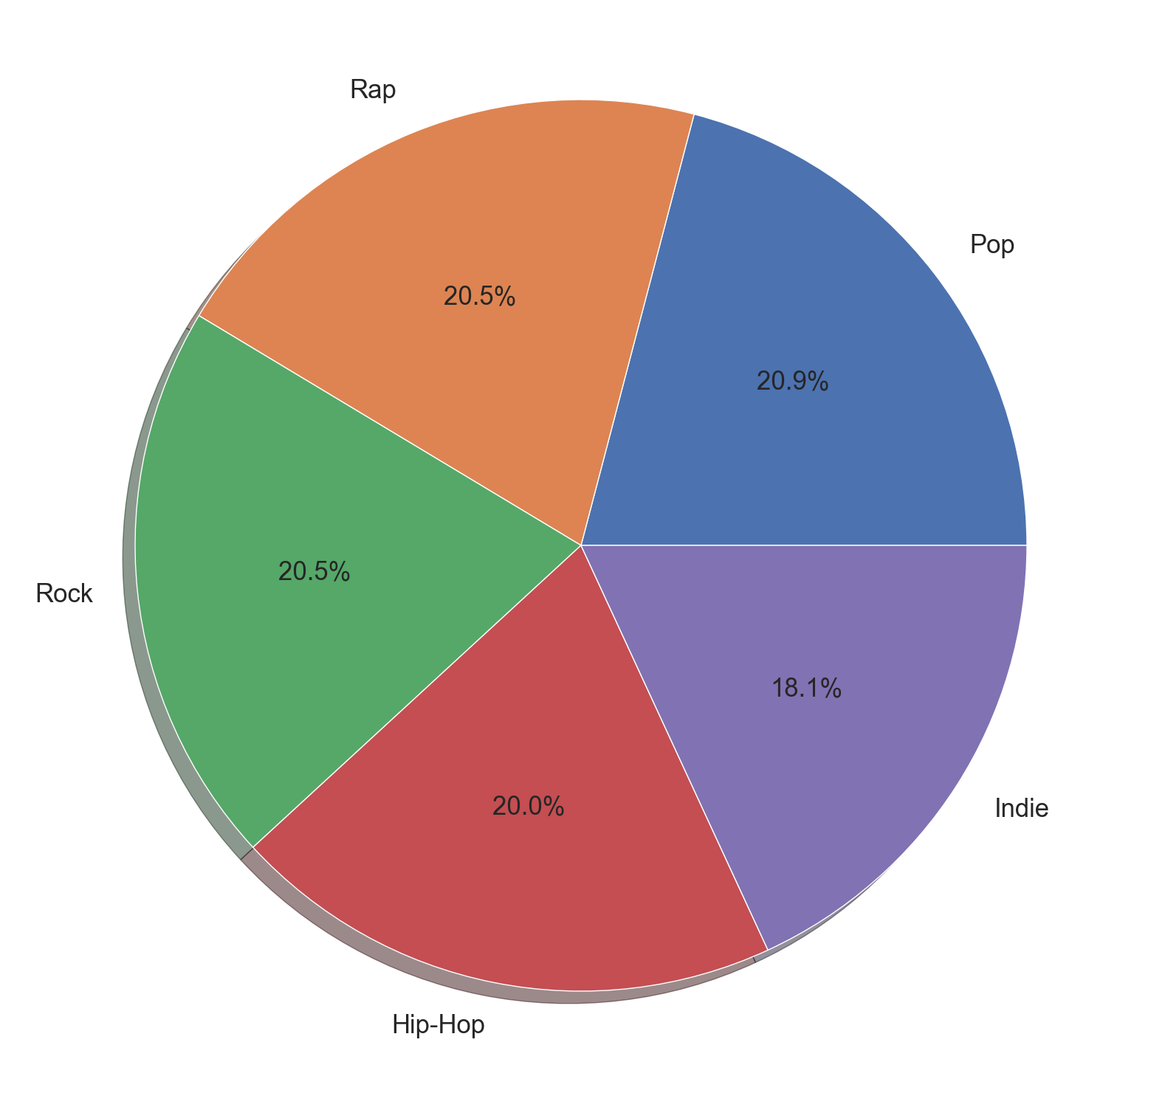
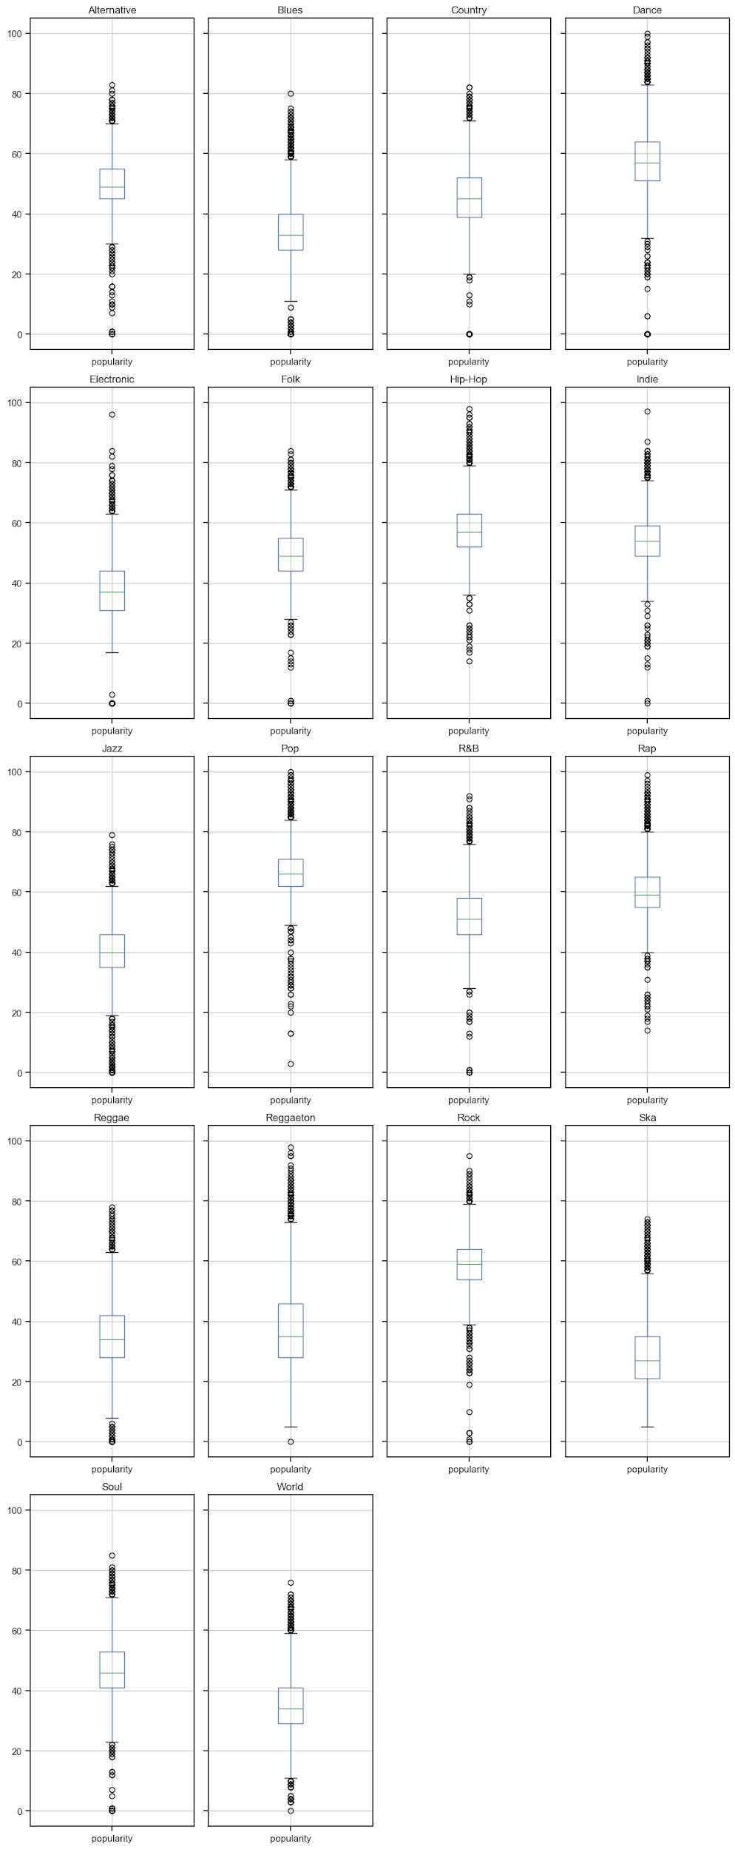
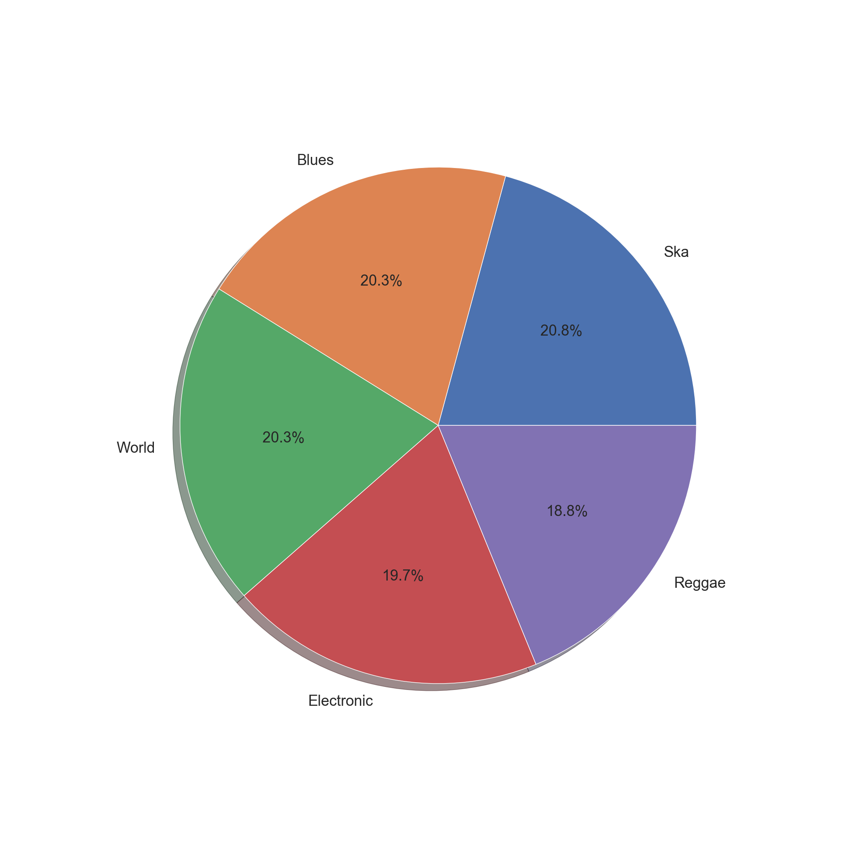

Slide 9
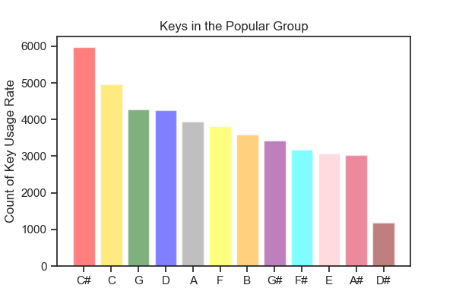
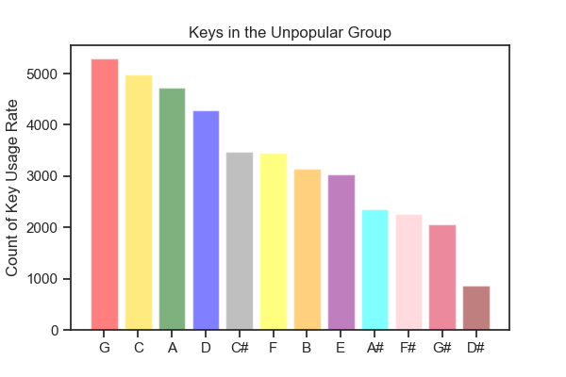
As we continued to review the data we notice that some of the columns are made of categorical data rather than numerical data. One of these categorical characteristics is the
Key column that represents the key in which the song is in. To get a better idea of variability of the different keys across the two groups, we used a bar chart to show the frequencies of each key in both the popular and unpopular groups.

Slide 10
Data Analysis
Now that we visualized some of the variability in the dataset, we wanted to see if we can build a regression model based on the musical characteristics that determine the popularity factor of a song.
In order to do so, we decided to start with regression analysis to see what characteristics correlate with popularity across the popular and unpopular groups. We started with some matrix plots and correlation heat map to see where the strongest correlations may be found.

Slide 11
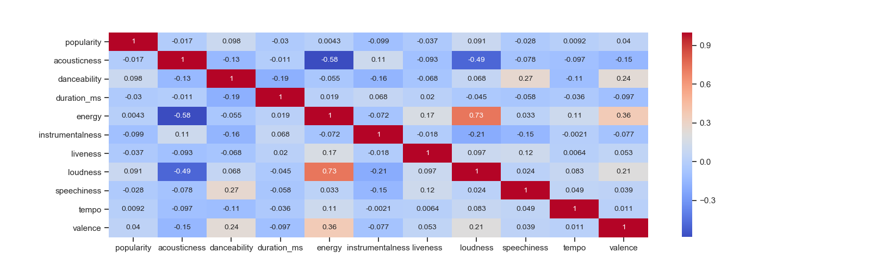
We did create correlation heat maps as well to help show the correlation factors of each of the variables in the dataset.
This is the heat map for the popular group

Slide 12
This is the heat map for the unpopular group

Slide 13
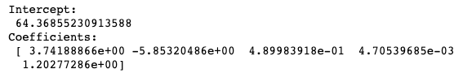

As we can see, there is not much correlation between the popularity score and the musical characteristics but we did want to try to create some simple multiple regression functions to test our hypothesis.
Below we created the regression models using the musical characteristics where the correlation coefficient was positive based on the heat maps above.

Slide 14
What Genres are Ideal for a Party?
We assessed the ‘partyability’ of each genre.
Partybility: Conduciveness of genre to a party-like setting.
Partybility score generated using average of five variables:
Popularity
Danceability
Energy
Loudness (in decibels)
Tempo (in beats per minute)

Slide 15
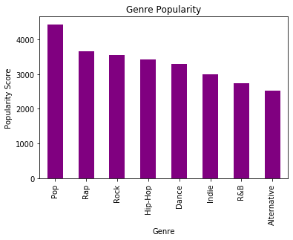

Slide 16
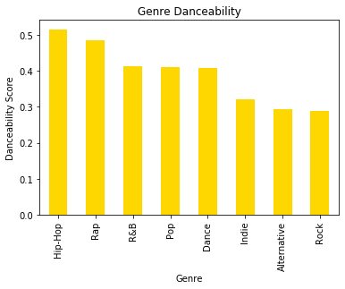

Slide 17
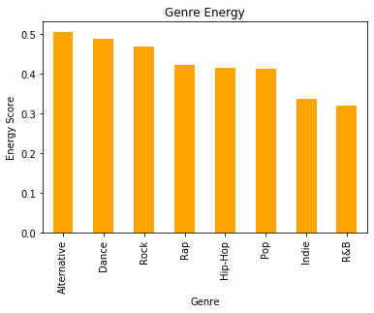

Slide 18
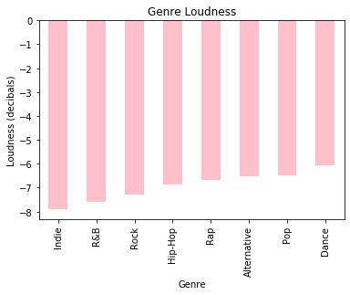

Slide 19
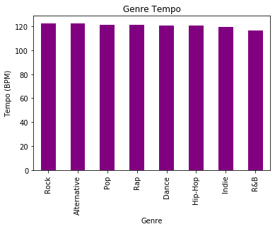

Slide 20
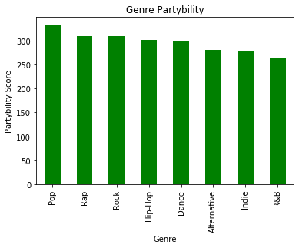

Slide 21
Conclusion

Slide 22
Analysis with Billboard API

Slide 23
Top Songs 2014-2019
Our Spotify data analysis showed that there was no correlation between the popularity and musical characteristic variables, our next focus was to analyze songs from a music chart that showed the progression of a song from its beginning position until its ultimate end (in other words rank throughout a specific time). The results of this will be compared to the previous slide showing the top genres and keys on Spotify.
The 3 charts shows Top Songs and its movement within Billboard’s Hot-100 chart. We specifically filtered the data to get songs that were ranked No.1.
By using the billboard.py wrapper, we were able to extract the ‘hot-100’ charts for the past 5 years (2014-2019).

Slide 24
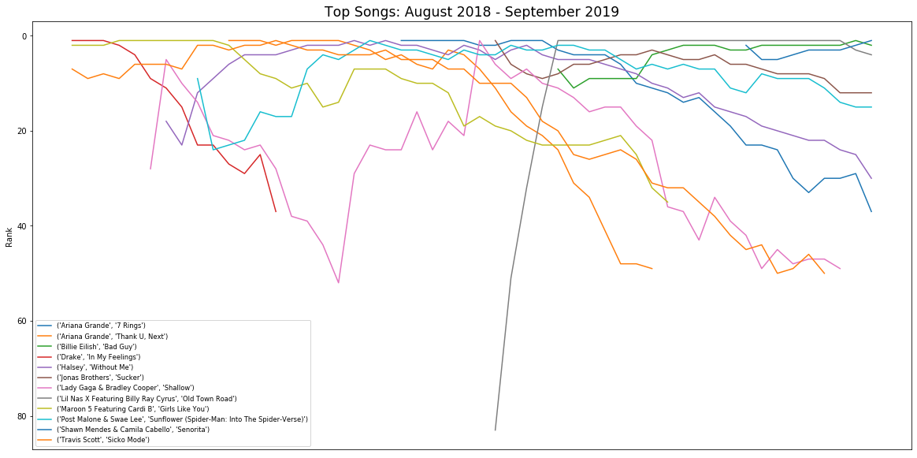

Slide 25
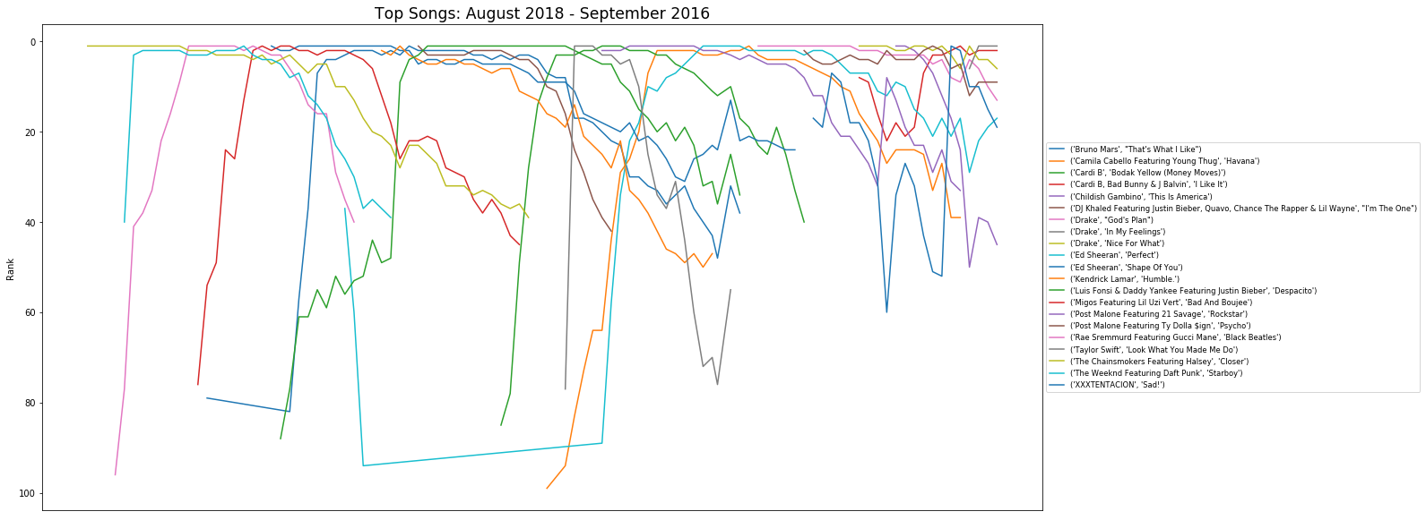

Slide 26
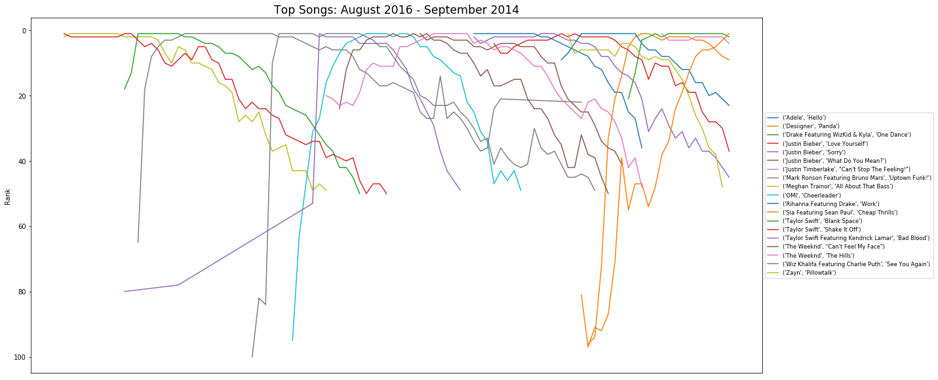

Slide 27
Top Songs
We found that the top songs throughout 2014-2019 showed two similarities:
Almost all songs fell into 3 of the most popular genres which are Pop, Hip-Hop and Rap.
Most songs were played in popular keys such as C#, A, and G
This correlates with the previous slide that showed which genres and keys were most popular. The Billboard data supports our Spotify analysis for popular genres and keys which means these two similarities found in the charts are required to create a popular song .

Slide 28
Spread in Rank 1: Who Spent the Longest in the Top Spot?
The previous slides visualize the lifetimes of the billboard’s “Hot-100” on the charts. The defining factor of all the songs shown previously is that they were all Number 1 at some point in their lifetime. We ask:
What is the average time that a song is ranked Number 1? What is the spread?
Are there trends to being ranked Number 1?
How normal is our data? Can we predict the future?

Slide 29
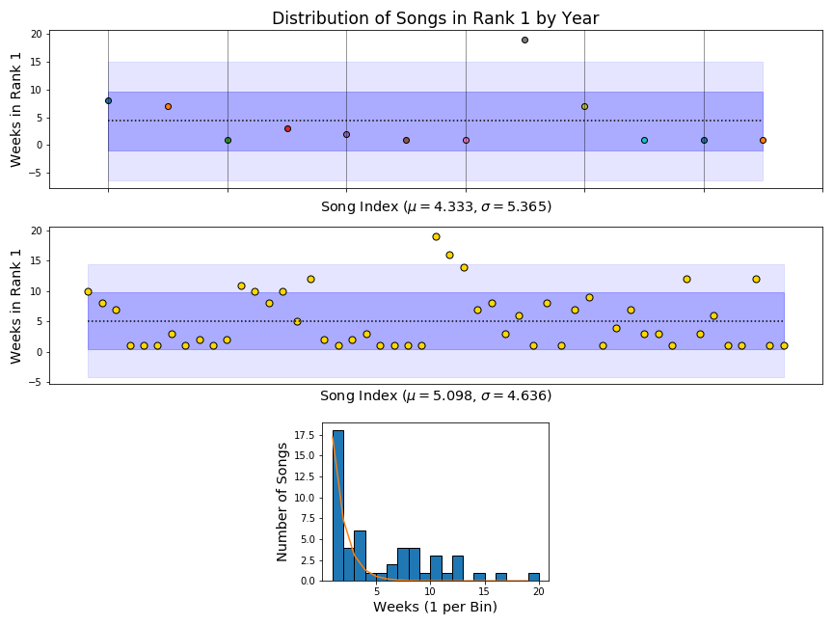

Slide 30
Conclusion
Our analysis of our Spotify Dataset and Billboard Data left us with 4 lasting impressions:
We cannot base a song’s popularity based on acoustic features.
Our classification of Partyability generated some promise in using acoustic features to categorize songs.
Billboard ‘Hot-100’ charts tell us Pop, Hip-Hop, and Rap were the most popular genres in the past 5 years.
On average a song is ranked 1 for 5 weeks. Most songs last 1-2 weeks ranked 1. Few songs are popular for more than couple months.

Slide 31
The End!
Thank You

